Slide 1
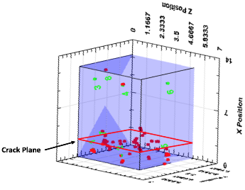
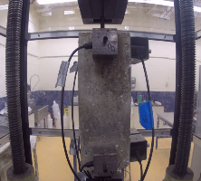
 | FACT SHEET
 | Acoustic Emission Monitoring of Prefabricated and Prestressed Reinforced Bridge Elements and Structures
& STIC Annual Meeting
RESEARCH PROJECT TITLE V-TRC 16-3: Monitoring Condition of Structural Elements during Accelerated Bridge Construction STUDY TIMELINE September 2016 – August 2018 PRINCIPAL INVESTIGATOR Dryver Huston Mandar Dewoolkar Tian Xia University of Vermont VTRANS CONTACT(S) Emily Parkany, Research Manager MORE INFORMATION This fact sheet was prepared for the 2017 VTrans Research Symposium & STIC Annual Meeting held on September 28, 2017 at National Life in Montpelier, VT. 8:00 am– 12:00 pm. Fact sheets can be found for additional projects featured at the 2017 Symposium at http://vtrans.vermont.gov/planning/research/2017symposium Additional information about the VTrans Research Program can be found at http://vtrans.vermont.gov/planning/research Additional information about the VTrans STIC Program can be found at http://vtrans.vermont.gov/boards-councils/stic | Introduction This project is to design and implement a reusable instrumentation system for evaluating the condition of prefabricated and prestressed reinforced concrete structural elements used in bridge construction, with an emphasis on fabrication and transport steps. Prefabricated and pre-stressed concrete bridge girders often suffer from cracking, with many appearing as diagonal cracks at the ends. These cracks are unlikely to be of structural concern, but may pose aesthetic and serviceability issues. Acoustic emission (AE) monitoring is a method for effectively identifying, locating and classifying cracking in solid materials. The operating principle is that cracking and other damage-related events generate elastic ultrasonic waves that propagate throughout a structural element and can be detected at a remote surface-mounted location. AE testing is an established technique for conventional concrete, but has yet to be applied extensively to Quality Assurance/Quality Control (QA/QC) activities for prestressed and prefabricated concrete. Methodology Assemble and test AE instruments, first in the laboratory and then in the field. Typical laboratory results appear in Figure 1 to Figure 3. Fig. 1 Pullout test Fig. 2 Beam failure Fig. 3 AE events at failure surface Conclusion and future steps Laboratory results indicate the viability of AE sensing technology for monitoring the condition of prefabricated concrete girders during fabrication and transport. Planned future work includes measurement of AE events on prestressed girders during fabrication and transportation to the Rockingham I-91 IM 091-1(66) bridges in collaboration with J.P. Carrara and Sons, Middlebury, VT. What are potential impacts? What is the benefit to VTrans? This research project addresses the issue of (QA/QC) of prefabricated pre-stressed concrete girders used in bridge construction through the use of a portable and reusable AE sensor system. If successful, the technique could be extended to monitoring girders during installation and in-service of the bridge, and future QA/QC efforts. The long term impact is the potential for increased serviceability values for bridges by reducing the level of cracking in prefabricated reinforced concrete elements.
2017 Research
Symposium

